Slide 1
Music Streaming App V2
Problem definition
Modern Application Development - II
Last Updated: 23-09-03

Slide 2
Frameworks to be used
Flask for API
VueJS for UI
VueJS Advanced with CLI (only if required, not necessary)
Jinja2 templates if required
Not to be used for UI
Bootstrap, if required (No other CSS framework is allowed)
SQLite for database (No other database is allowed)
Redis for caching
Redis and Celery for batch jobs
It should be possible to run all the demos on the student's computer, which should either be a Linux based system or should be able to simulate the same. You can use WSL for Windows OS.

Slide 3
Music Streaming App
It is a multi-user app (one required admin and other users or creators)
Used for streaming music/reading lyrics
User can play, read lyrics, rate songs, create playlists
Creators can add new songs/albums/lyrics
Each Album may have
ID
Name
Artist etc.
Each song will have
ID
Name
Lyrics
Genre
Duration
Date created etc.
Every album can have a number of songs
System will automatically show the latest albums/songs added
Terminology
Albums, Playlists
User, Creator, Admin
Songs - lyrics

Slide 4
Similar Products in the Market:
Saavn App
Web, IOS and Android
Spotify
Web, IOS and Android
These are meant for exploring the idea and inspiration
Don’t copy, get inspired

Slide 5
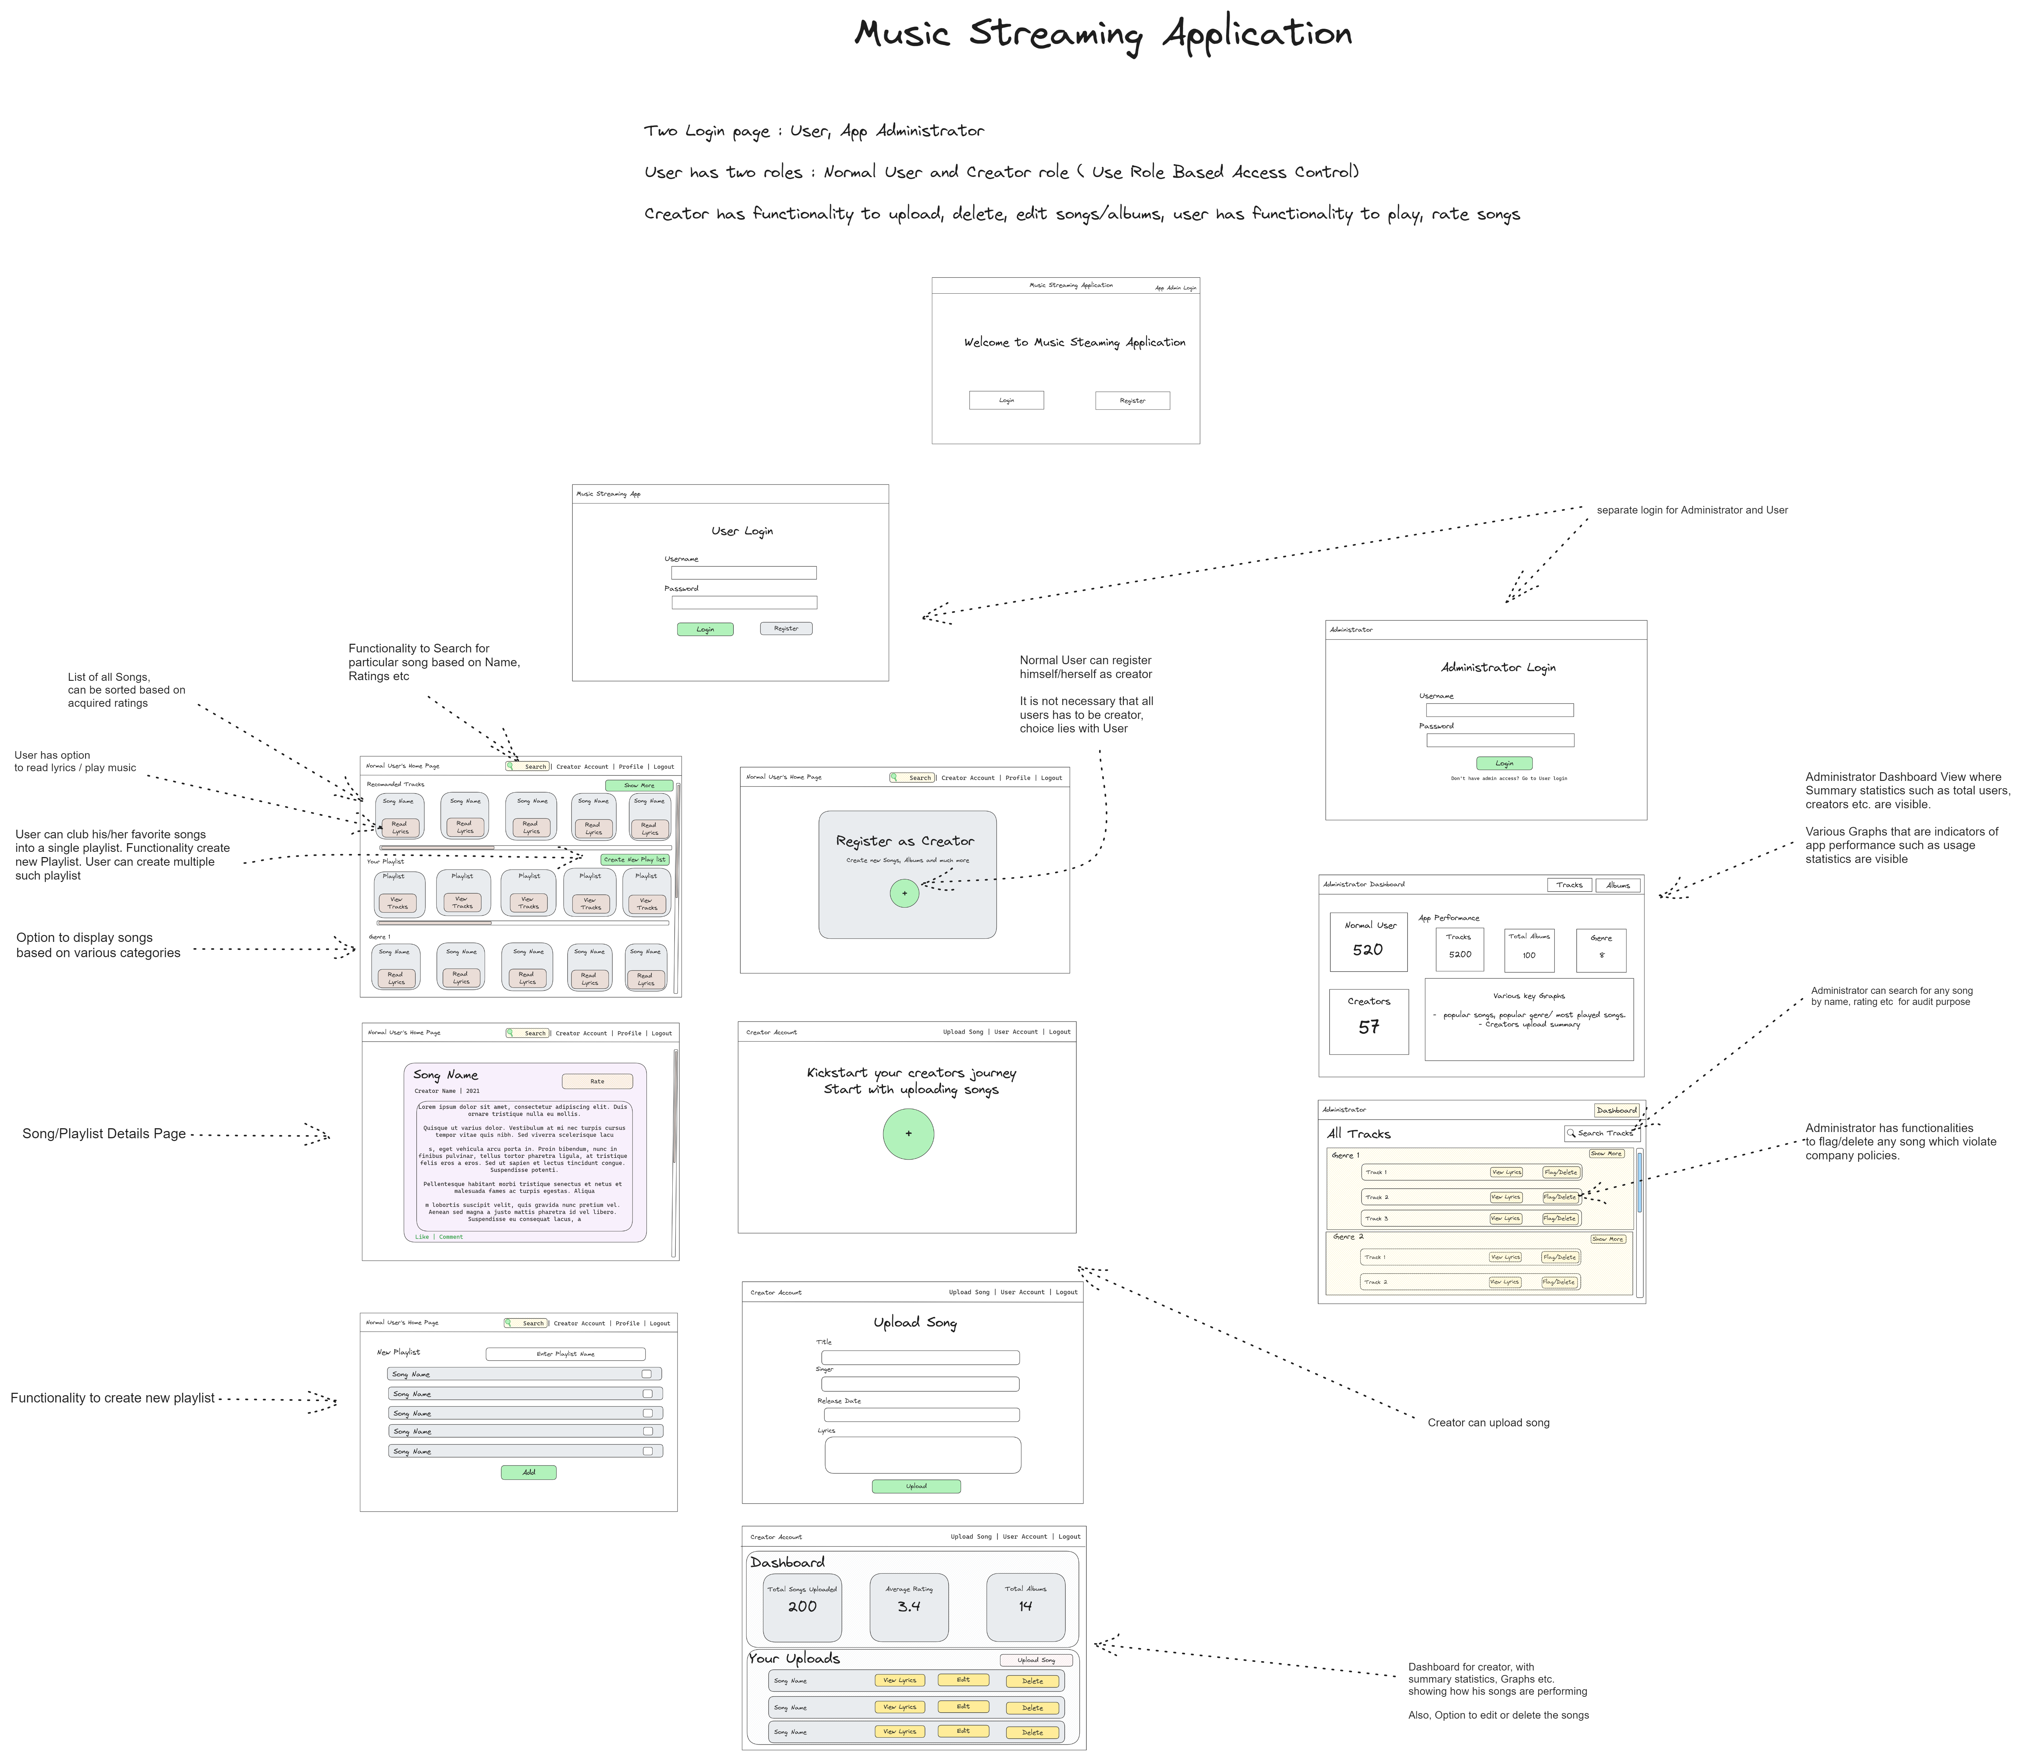
Wireframe

Slide 6
Core Functionality
This will be graded
Base requirements:
Admin’s Dashboard
General User signup and login (using RBAC)
Mandatory Admin Login (using RBAC)
Creator Signup and Login (using RBAC)
General User Profile
Creator Profile (users registered as creators)
Song Management
Playlist Management
Search functionality for songs/playlist
Backend Jobs
Export Jobs
Reporting Jobs
Alert Jobs
Backend Performance

Slide 7
Core - Admin and User Login
User should be authenticated using username or email and password
Use Flask Security or JWT based Token Based Authentication only
Registration form for General User and Creator is required. You can use the same form for both.
New admin cannot be created.
Suitable model for user (model that stores all the type of users and differentiates them correctly based on their role)
The application should have only one admin.

Slide 8
Core - General User functionalities
View all the existing songs/Albums
Read lyrics, create playlists of existing songs (one or more)
Rate existing songs/albums
Flag a song/album

Slide 9
Core - Creator functionalities
All the functionalities of a general user
Create a new song/album
Storage should handle multiple languages - usually UTF-8 encoding is sufficient for this
Edit an existing song/album
Change lyrics, artists name, song attributes, album name, album listing
Remove an existing song/album
Assign a song to a particular album

Slide 10
Core - Admin functionalities
Admin dashboard to monitor app statistics like total users/creators/albums
Statistics on how songs are performing
Ability to remove songs/albums

Slide 11
Core - Search for songs/albums
Ability to search albums based on artists, genre etc.
Ability to filter songs based on rating

Slide 12
Core - Daily Reminder Jobs
Scheduled Job - Daily reminders on Google Chat using webhook or SMS or Email
In the evening, every day (you can choose time of your choice)
Check if the user has visited the app.
If no, then send the alert asking them to visit

Slide 13
Core - Scheduled Job - Monthly Activity Report
Scheduled Job - Monthly Activity Report
Come Up with a monthly progress report in HTML or PDF (email)
The monthly activity report is meant for a creator
The activity report can consist of songs & albums created, ratings received on songs/albums etc.
On the first day of the month
Start a job
Create a report
Send it as email

Slide 14
Recommended (graded)
Add and play .mp3 files for songs
Validation
All form inputs fields - text, numbers, dates etc. with suitable messages
Backend validation before storing / selecting from database

Slide 15
Optional
Styling and Aesthetics
Subscriptions or paid versions of the app
Autoplay, shuffle songs in a playlist

Slide 16
Evaluation
Report (not more than 2 pages) describing models and overall system design
Include as PDF inside submission folder
All code to be submitted on portal
A brief (2-3 minute) video explaining how you approached the problem, what you have implemented, and any extra features
This will be viewed during or before the viva, so should be a clear explanation of your work
Viva: after the video explanation, you are required to give a demo of your work, and answer any questions
This includes making changes as requested and running the code for a live demo
Other questions that may be unrelated to the project itself but are relevant for the course

Slide 17
Instructions
This is a live document and will be updated with more details and FAQs (possibly including suggested wireframes, but not specific implementation details) as we proceed.
We will freeze the problem statement on or before 2nd October, beyond which any modifications to the statement will be communicated via proper announcements.
The project has to be submitted as a single zip file.

